Slide 1
Ambisonics
Capturing the Soundfield

Slide 2
What is Ambisonics?
“encompasses encoding, storage, and rendering of directional auditory data by formulating the spatial sampling of an infinitesimal sound field...” - “Ambisonics Understood” Armstrong/Kearney
Capture, reproduction, description of sound waves from all directions on the surface of a sphere
  Superposition of direct, reflected. Diffuse, diffracted waves

Slide 3
(continued)
Born out of Mid /Side
  Review of pressure & velocity transducers
    First order polar patters
  Work of Blumlein, Michael Gerzon and others
  Defined a 4-channel system
Loudspeaker agnostic
Channel-based

Slide 4
Components of the soundfield
W (0th order) = pressure (omni)
First order – 3 gradients (bidirectionals)
  X = front/rear
  Y = left/right
  Z = up/down

Slide 5
In practice
Impossible to get 4 microphones truly coincident
Sphere concept:
  4 cardioids arranged in Tetrahedron

Slide 6
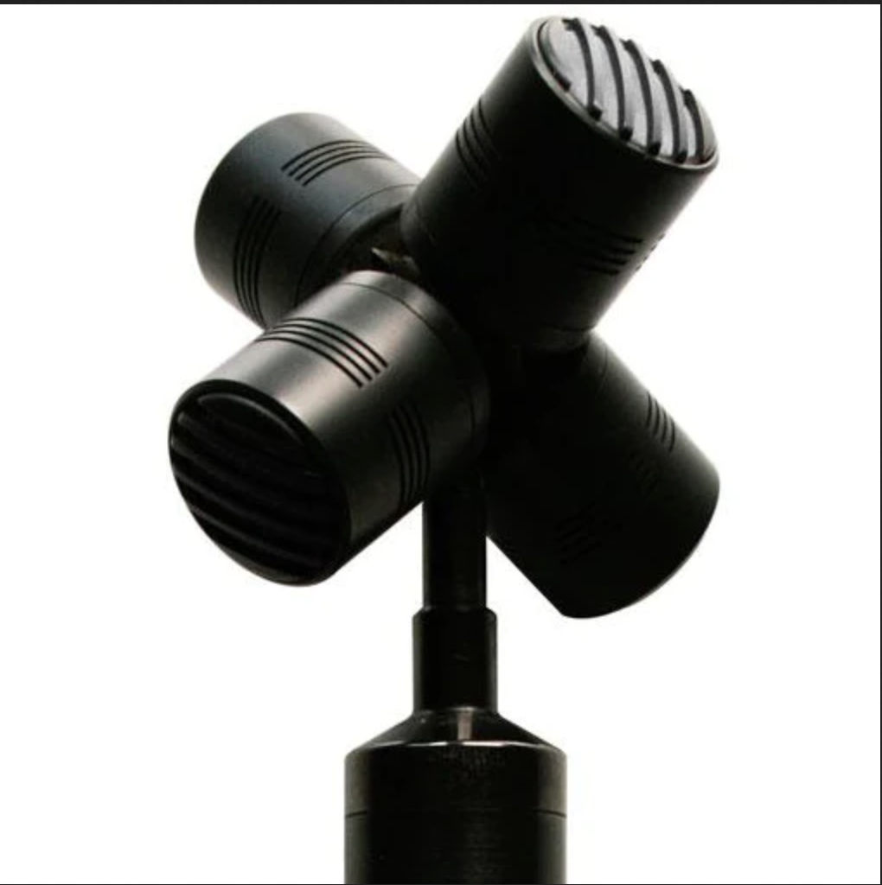
Tetrahedral array

Slide 7
Into the Soundfield
https://youtu.be/X23hZNoSkUs

Slide 8
Formats
A-format
  Directly from the microphone (4 cardioids)
  LF, LB, RF, RB
B-Format
  Encoded into W,X,Y,Z
C format
  “Consumer”
  UHJ – for broadcast & streaming

Slide 9
Higher order Ambisonics
WXYZ = First Order Ambisonics (FOA)
  Spatial sampling
Higher Order Ambisonics (HOA)
  Improved resolution and accuracy
  Involves additional spherical harmonics
  More channels (order + 1)²

Slide 10
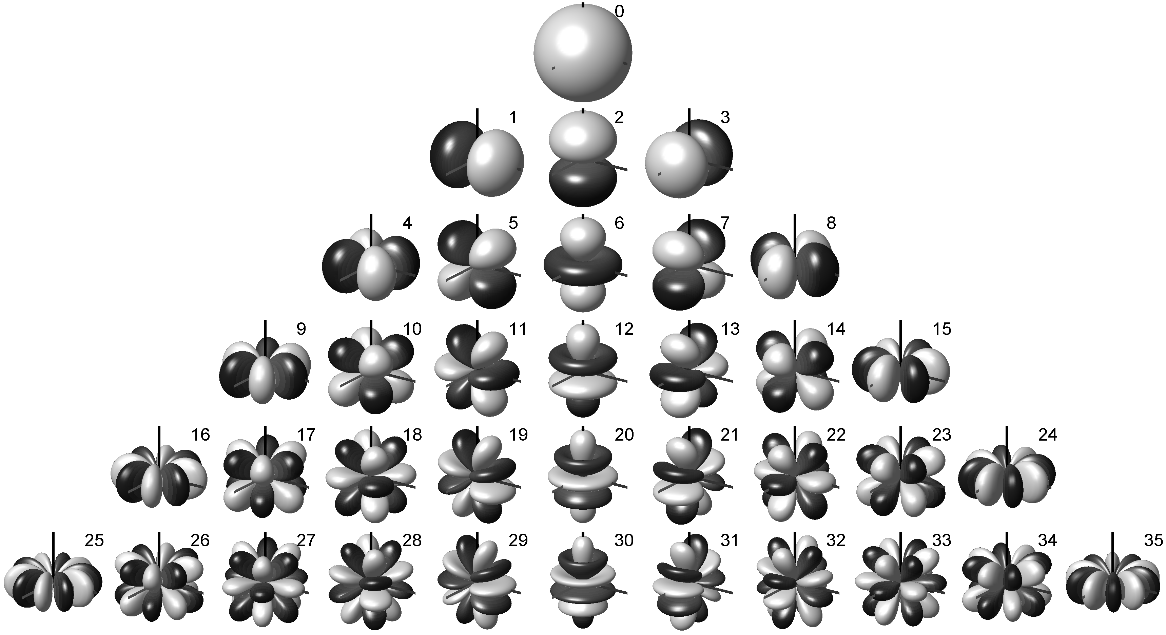
Spherical Harmonics

Slide 11
To show
Eigen mic
Zylia
  6DoF
Recording & decoding

Slide 12
File formats – channel order
Furse-Malham (FuMa)
  WXYZ
AmbiX (Ambisonics eXchange)
  WYZX
  Accepted standard
  Works better with HOA

Slide 13
Listening End
Can be decoded for ANY speaker layout
  Captures all directions – including height
  Any number of speakers
    Mono, stereo, surround, immersive compatible
  No “front” - can be rotated freely

