Slide 1
Binaural
Full immersion in the Soundfield

Slide 2
What is binaural?
“Two ears”
Different from stereo
  In stereo both ears hear both speakers
  Stereo is loudspeaker-based
Binaural requires no crosstalk between channels!
  Generally headphone-based

Slide 3
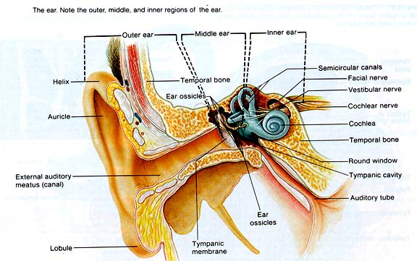

Slide 4
Localising Sound in a 3D Space
Interaural time difference
Interaural intensity difference
What about height?
What about front/rear differentiation?

Slide 5
Spherical Acoustical Baffle
Your head creates acoustic shadowing
  Begins around 700 Hz
  Affects frequency response at each ear

Slide 6
Roll of the Pinnae
Folds create a delay network
Delay patterns provide cues for height, azimuth & direction
Even in “one-eared” persons
Coupled with the baffle (i.e. your head) “Colours” the sound depending on angle of incidence

Slide 7
HRTF
Head-Related Transfer Function
Transfer Function is a mathematical model
  In this case describes the frequency response of every angle of our “head-ear-pinnae” system
  Mathematical model = Digital Signal Processing
Every person has a unique HRTF

Slide 8
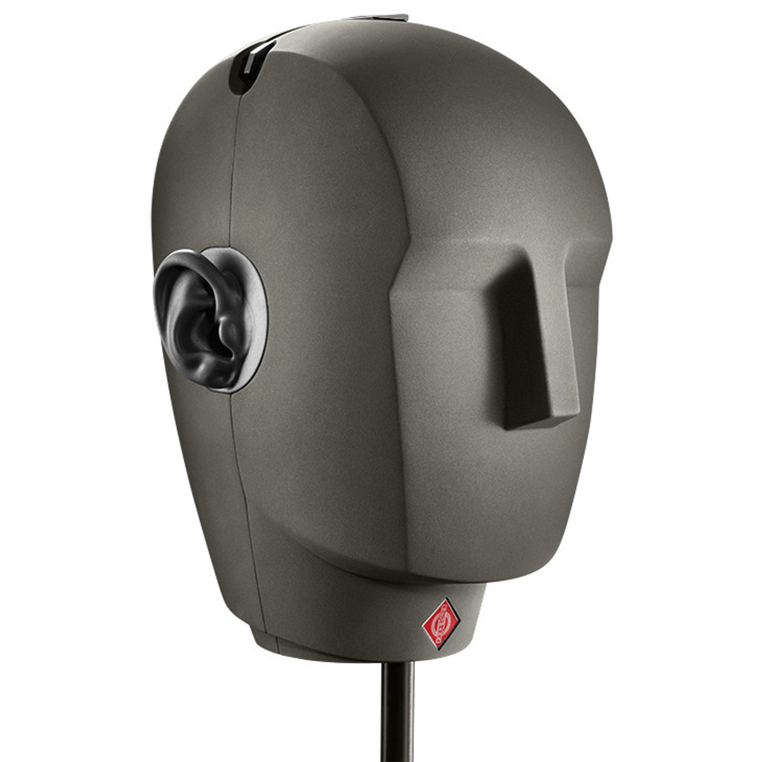
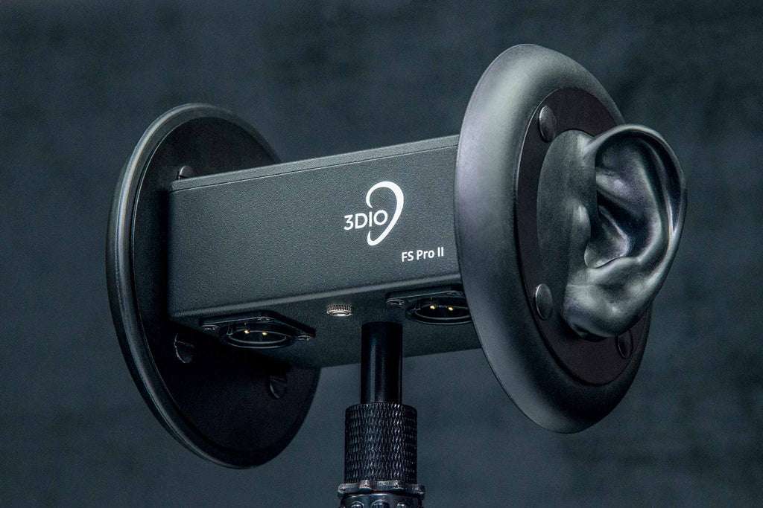
Binaural Recording

Slide 9
Problems with Dummy Head recording
Perspective is “baked in”
  Humans are used to turning their heads – dummy head recordings can’t be “turned”
  Perspective cannot be changed after the fact

Slide 10
Binaural Processing
Binaural mixes can be made from multi-mic’ed and Ambisonic recordings
Mix is converted to Ambisonics, and then an HRTF is imposed on the source depending on its angle to the listener

Slide 11
Binaural Future?
Trued 3D sound is only possible with Binaural
85% of music listeners consume most of their music while wearing headphones
Personalised HRTF’s are on the way

